Slide 1
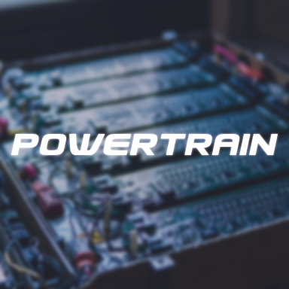

Slide 2

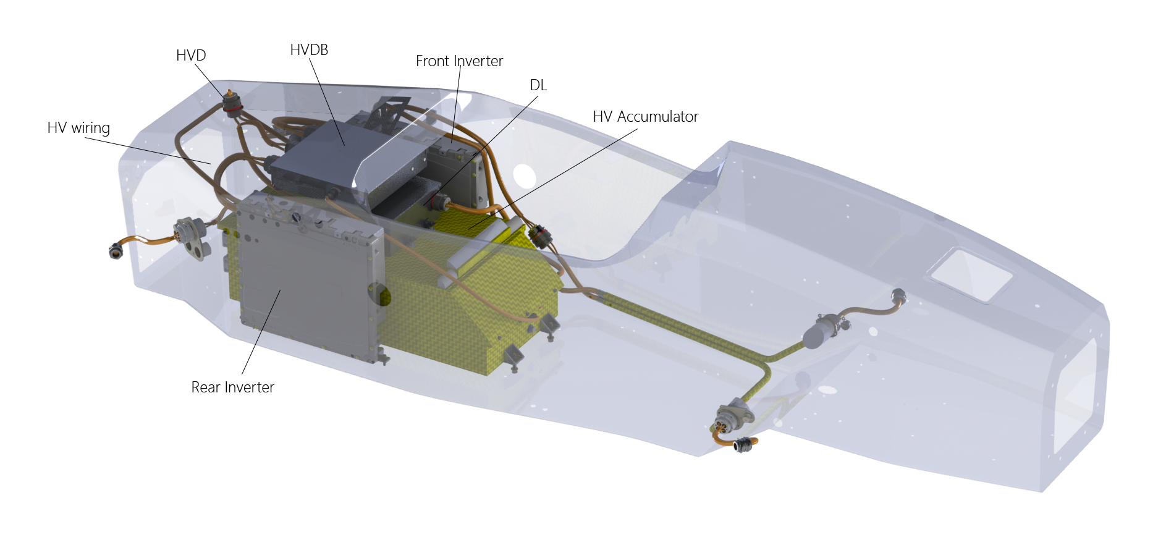
POWERTRAIN
POWERTRAIN SYSTEM
HV BATTERY
MOTORS
COOLING SYSTEMS
INVERTER
LV BATTERY

Slide 3
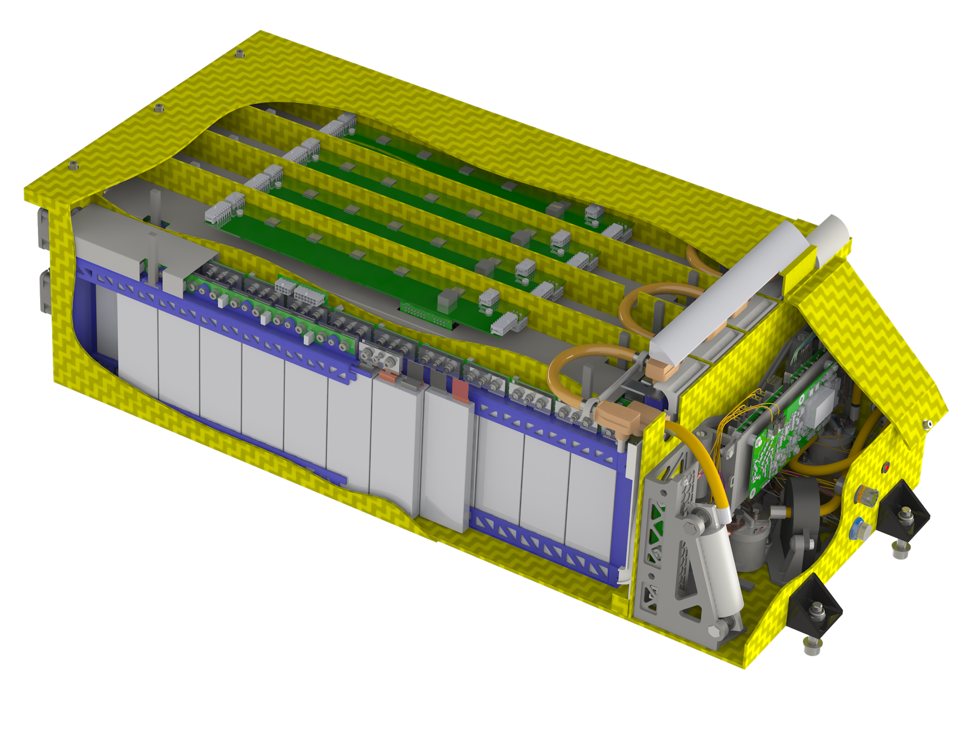
POWERTRAIN
HV BATTERY: ELECTRICAL DESIGN
BMS: Battery Management System
Vmax = 596,4V
Pmax = 80kW
Configuración: 142s2p
Voltage and temperatura sensing
New battery every two years
new one for this season
Li-Po Pouch
Control Zone

Slide 4
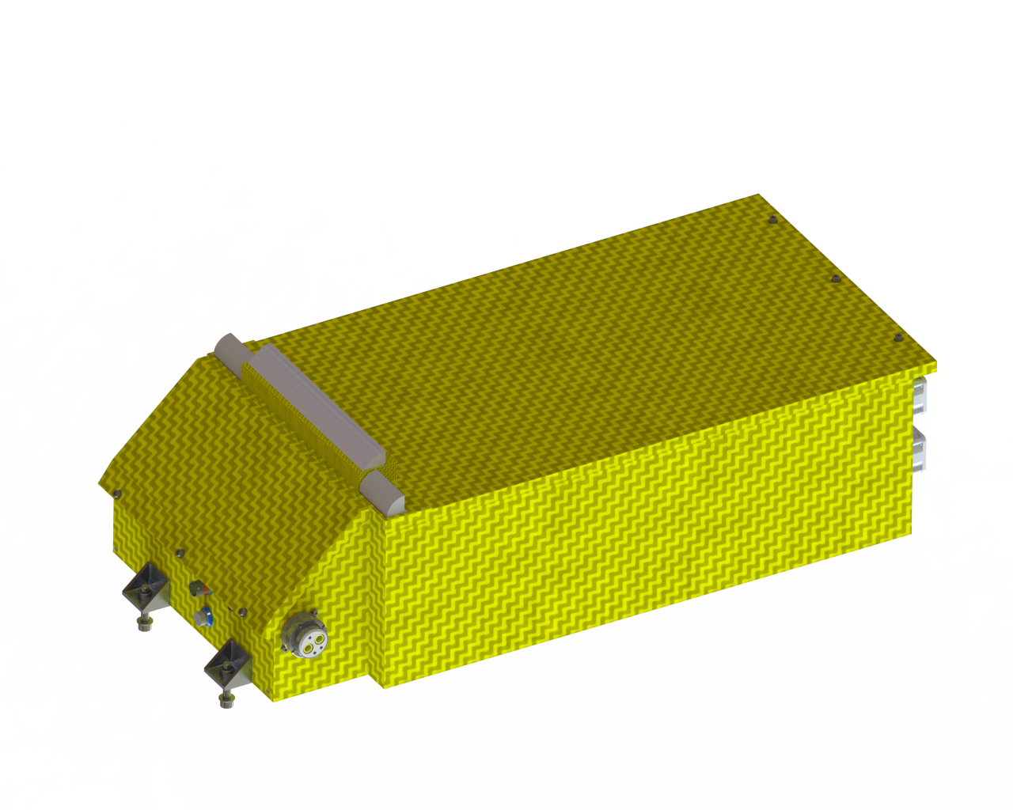
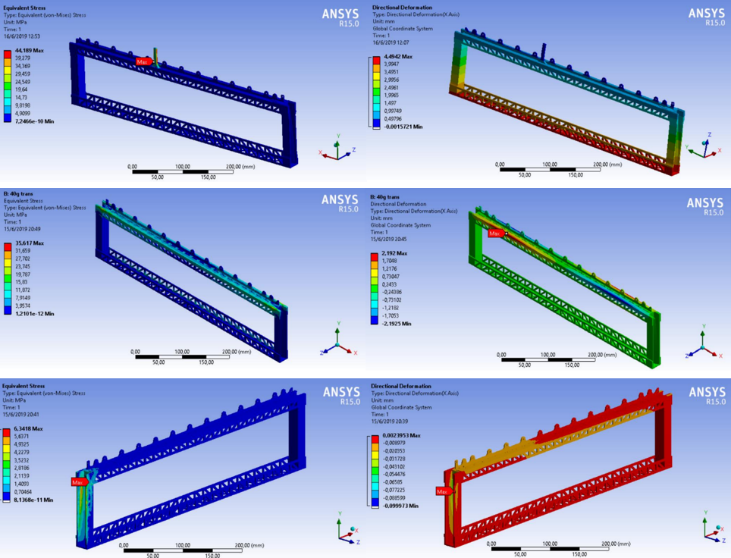
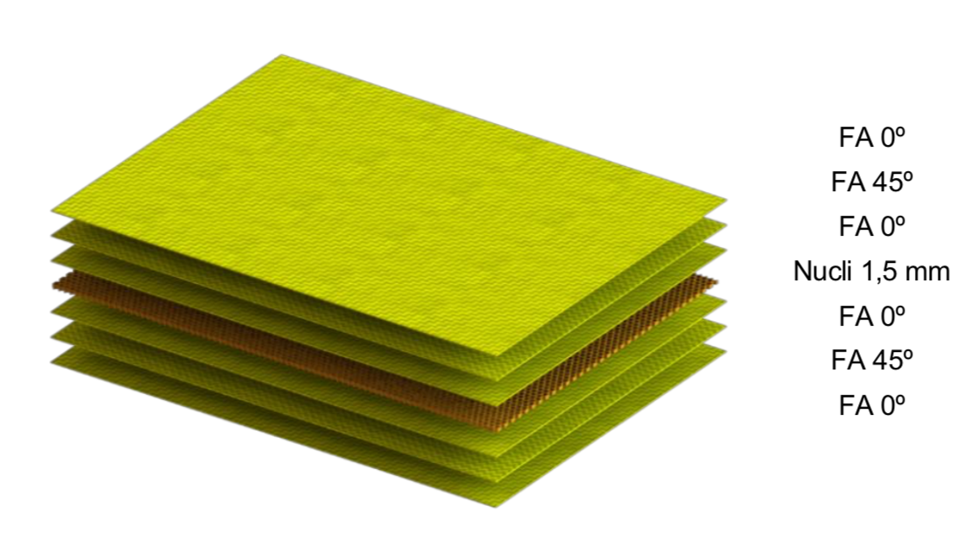
POWERTRAIN
HV BATTERY: STRUCTURAL DESIGN
Battery desing and lamination

Slide 5

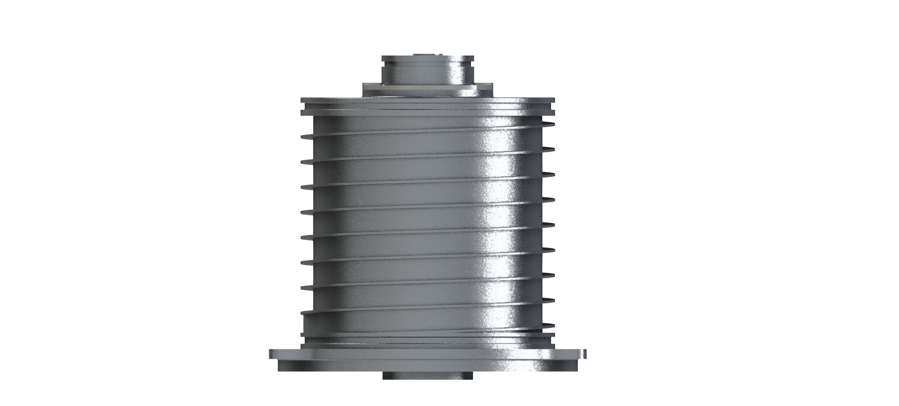
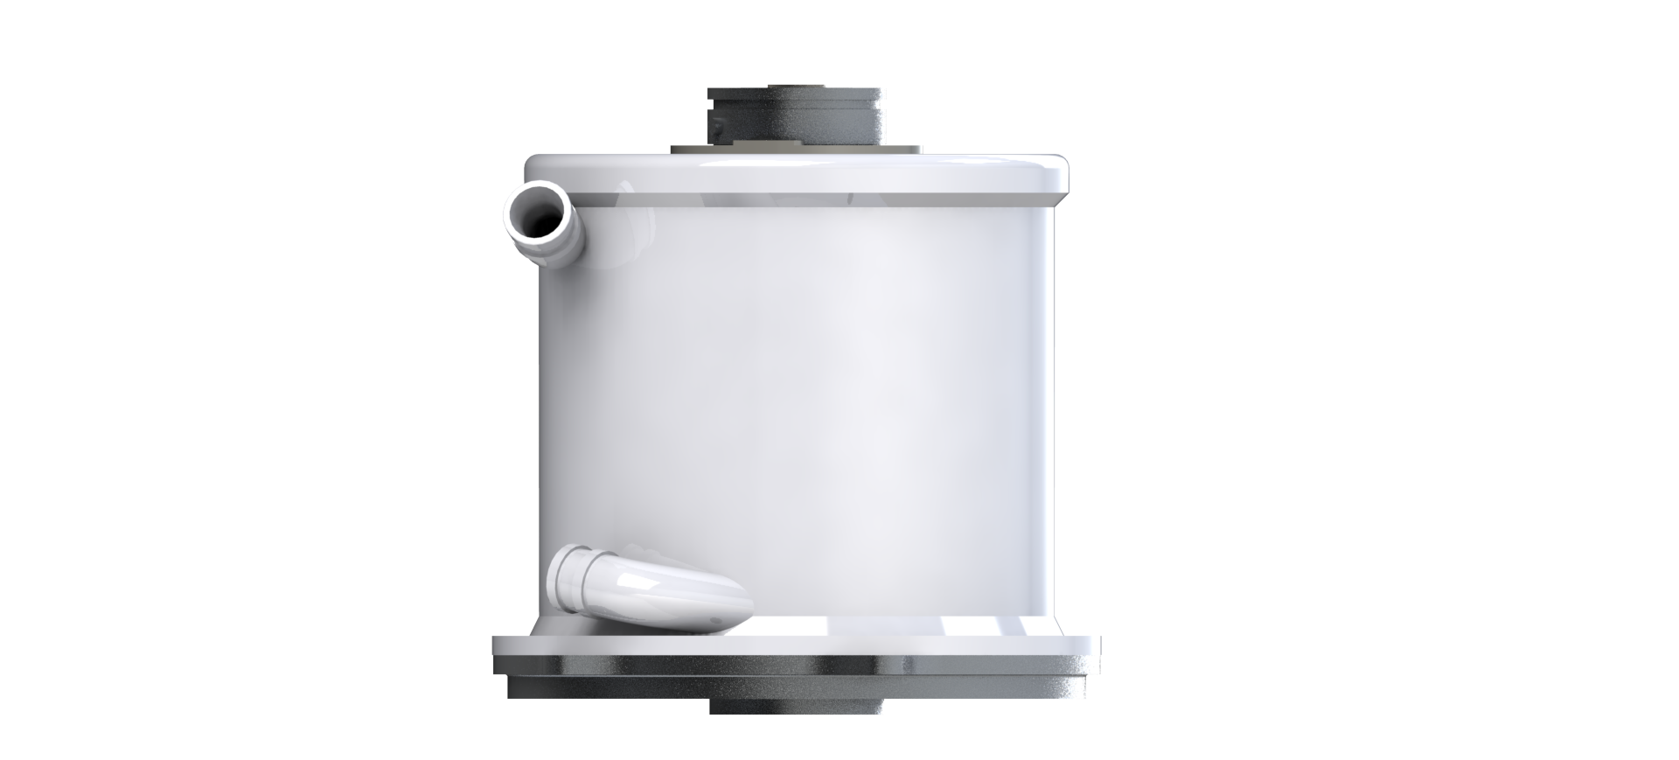
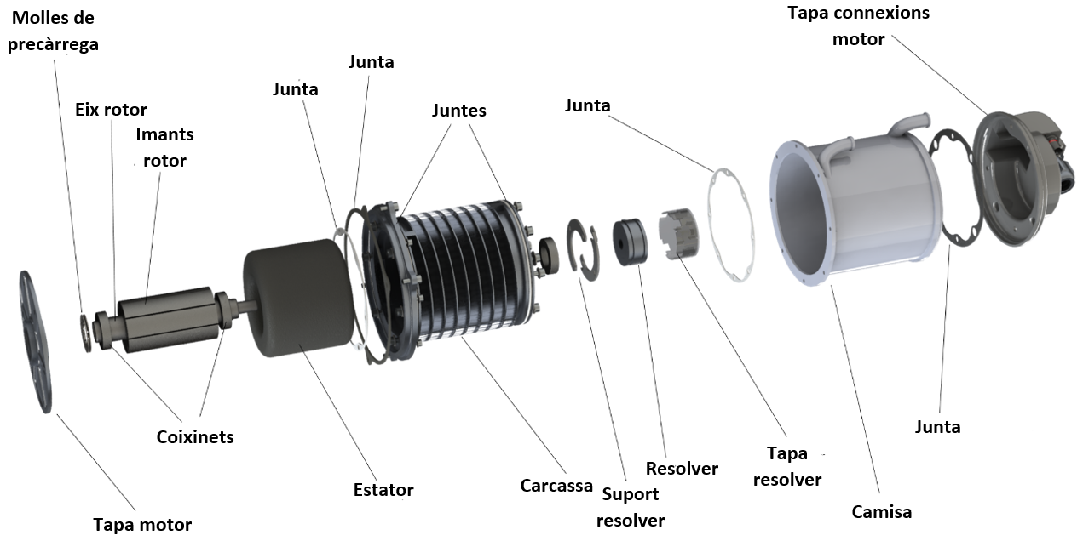
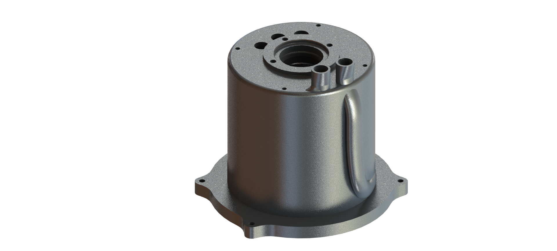
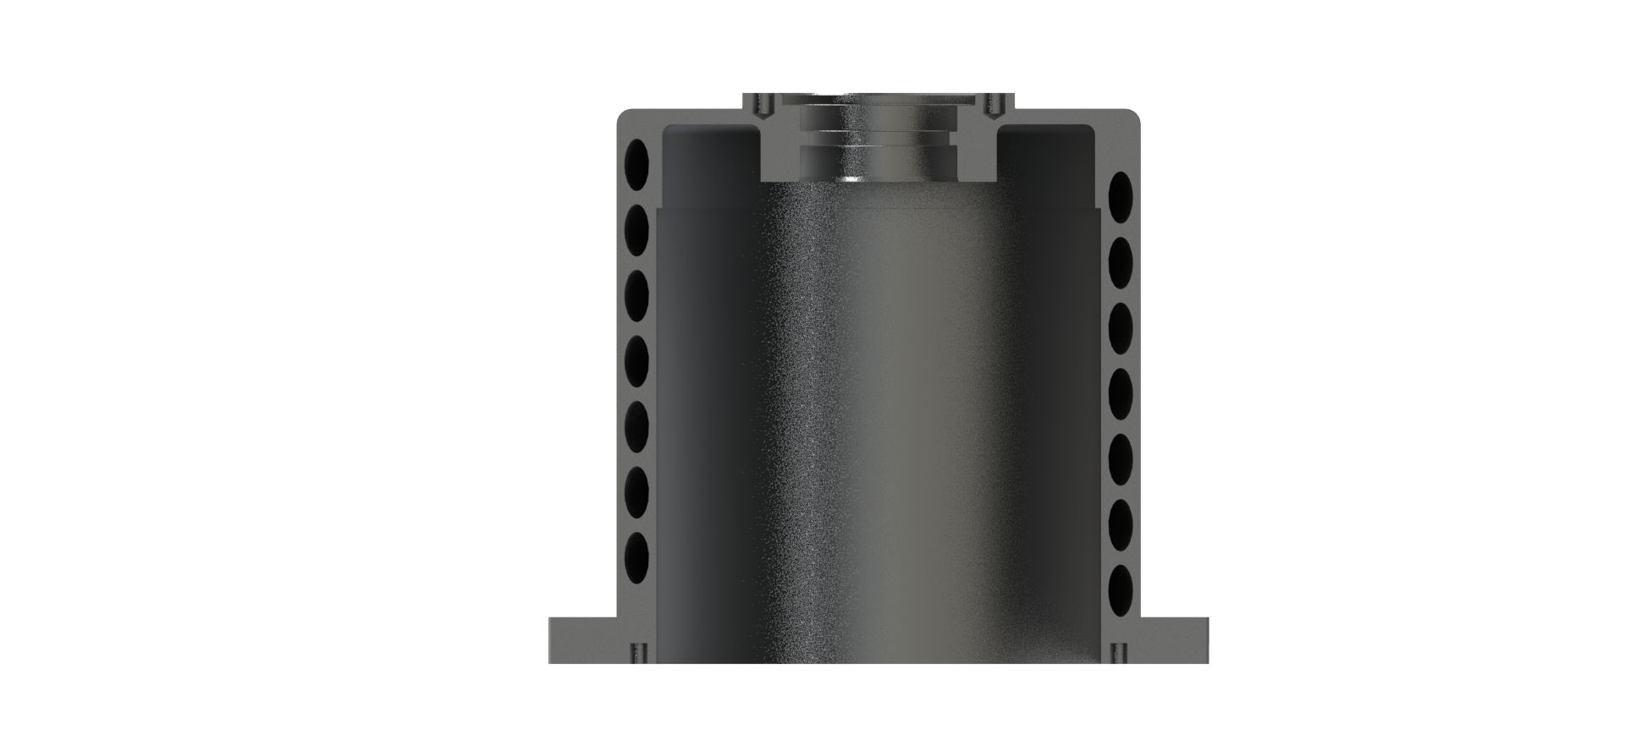
POWERTRAIN
4 motors
Permanent Syncronous
Max torque = 29,1 Nm
Weight = 3,5kg
Pmax = 35kW (46,94CV)
MOTORS
New 3D printed jackets to increase reliability

Slide 6
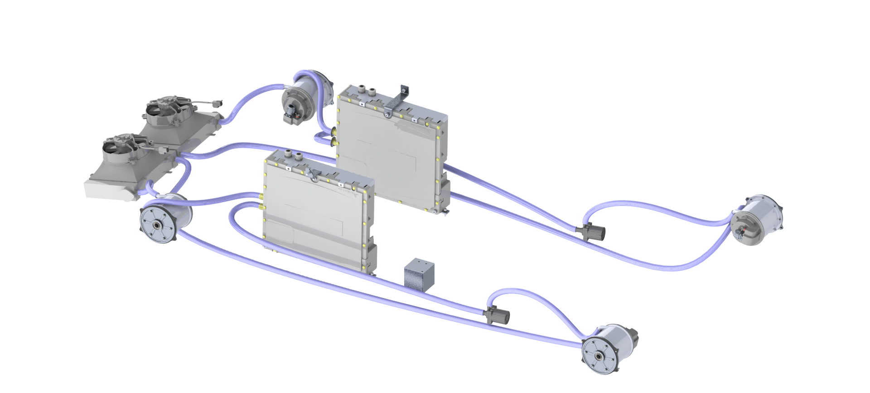
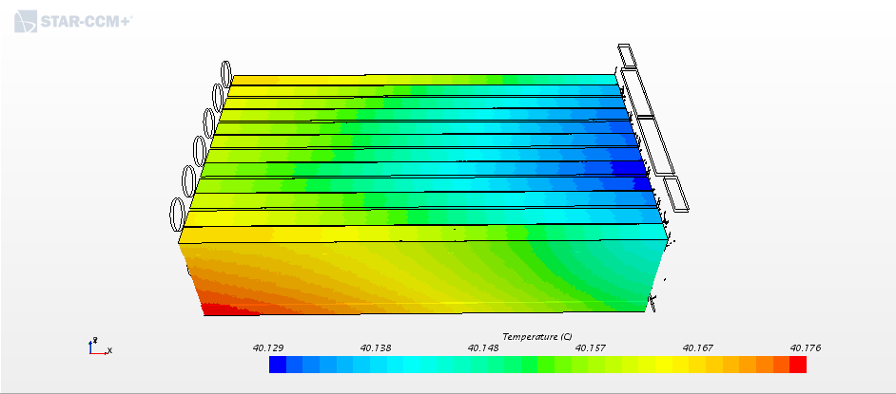
POWERTRAIN
COOLING SYSTEM
3 independent cooling systems

Slide 7
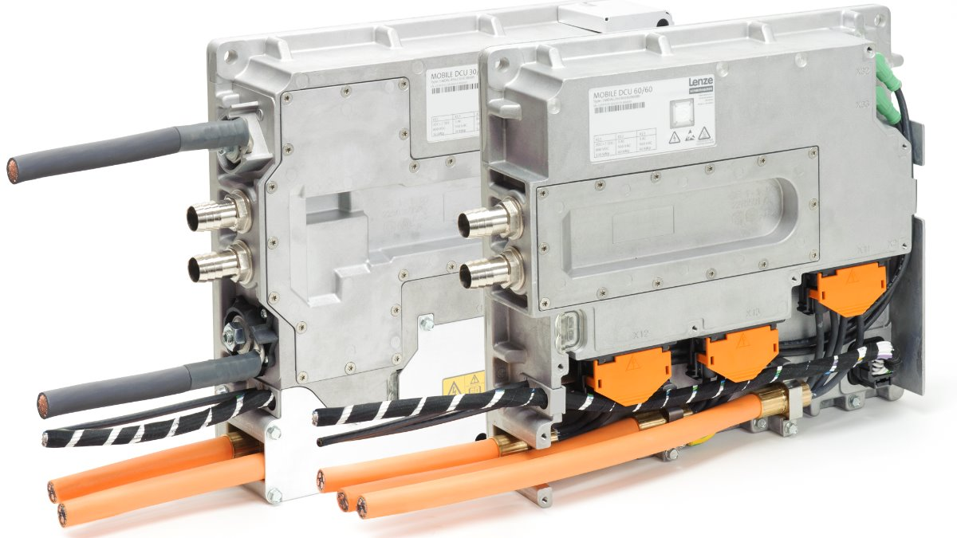
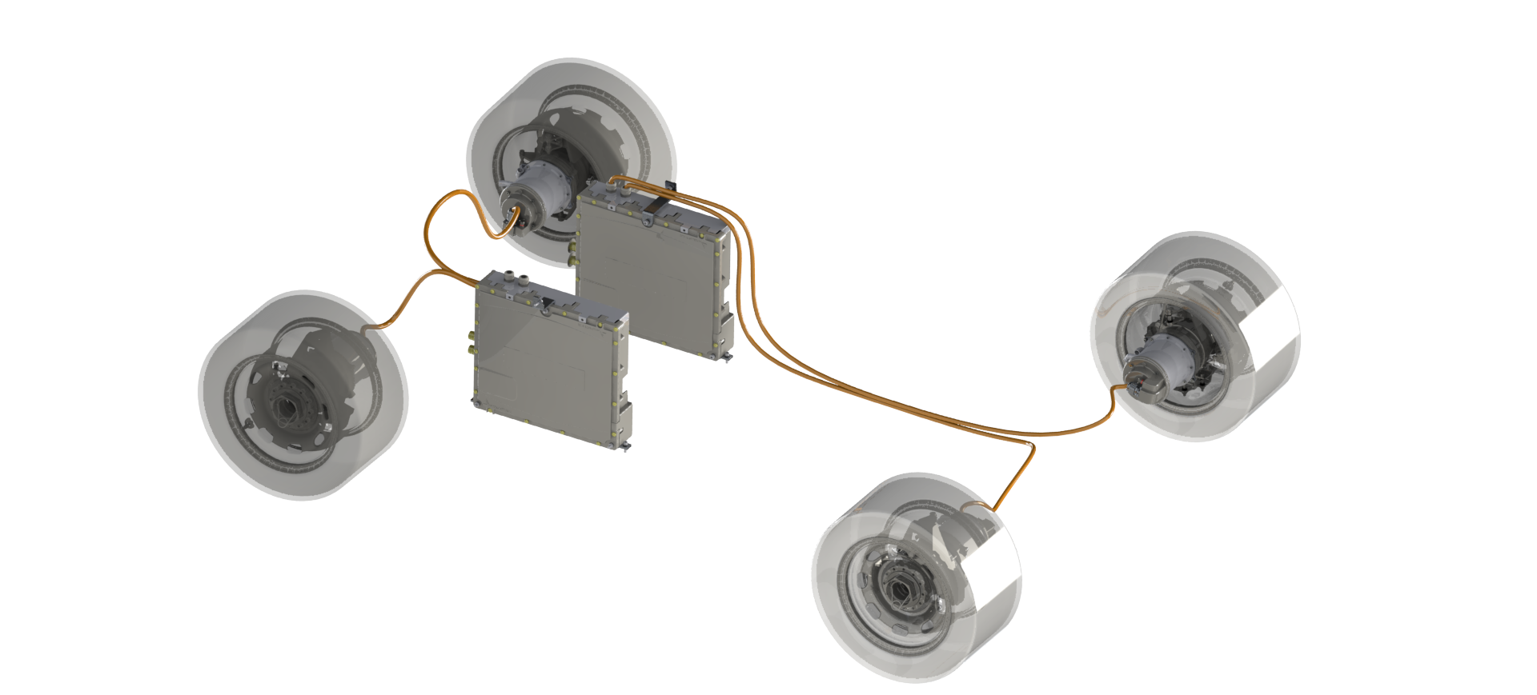
POWERTRAIN
INVERTERS
LENZE MOBILE DCU
with 2 modules
Pmax per module= 60 kW
7,4 kg

Slide 8
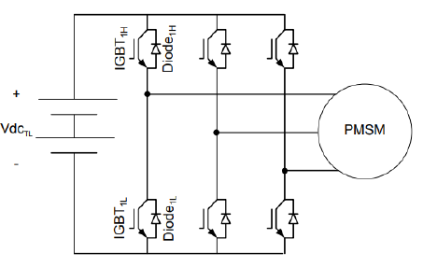
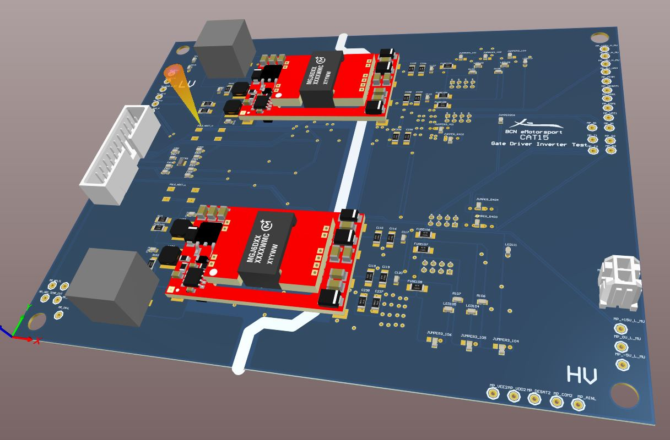
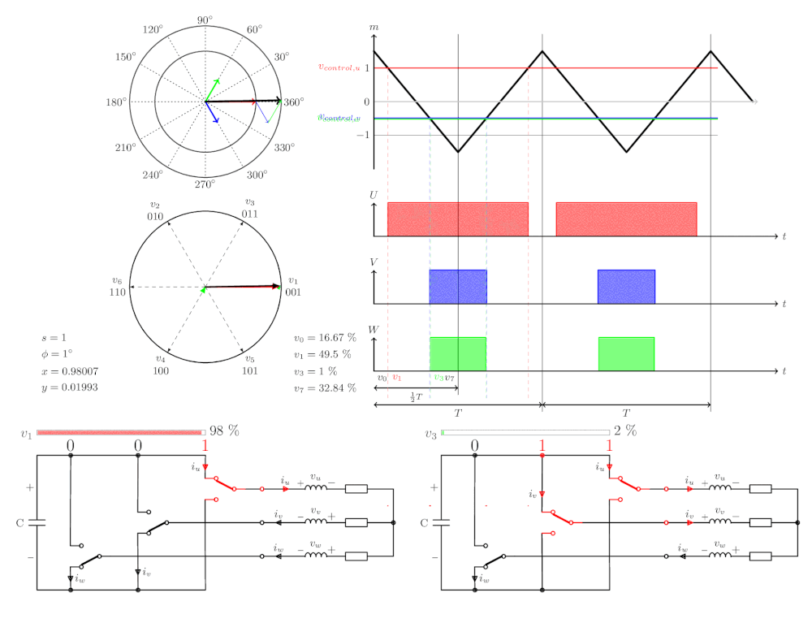
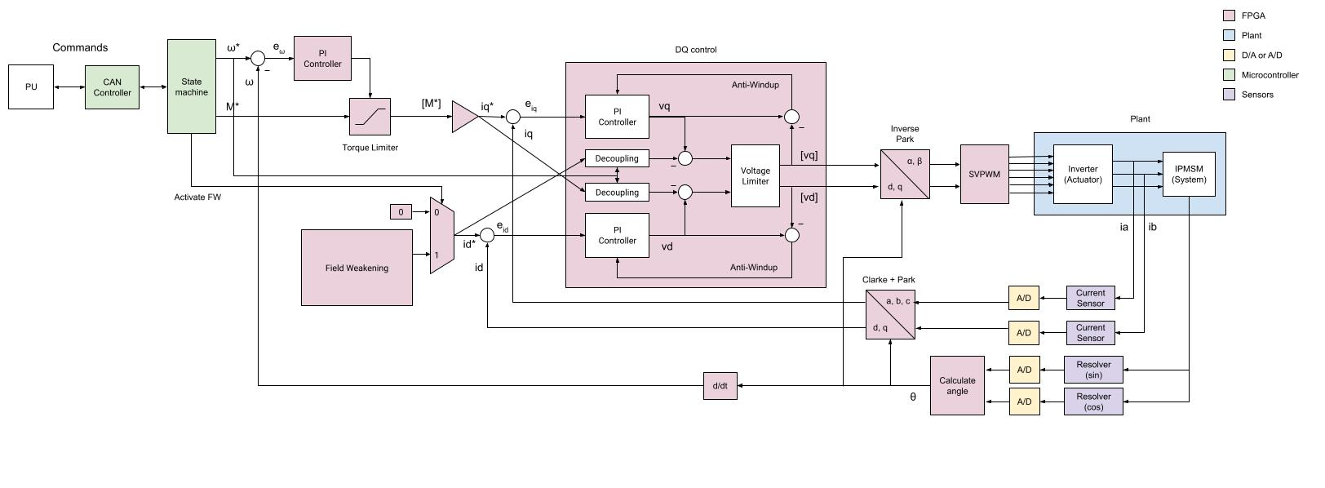
POWERTRAIN
SELF-MADE INVERTER
Combines power electronics with development of control algorithms in FPGA
We "climb" on the rotor to achieve linear control

Slide 9

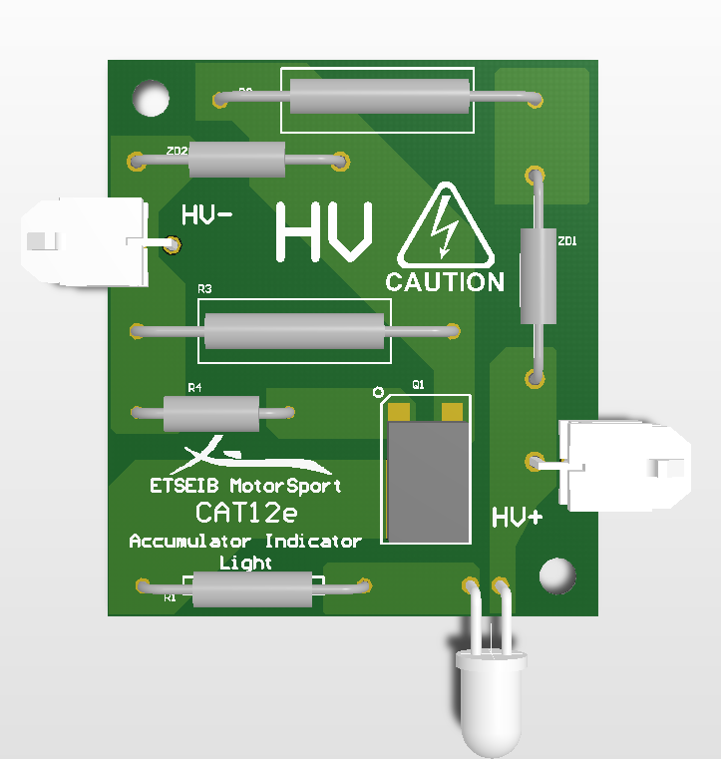
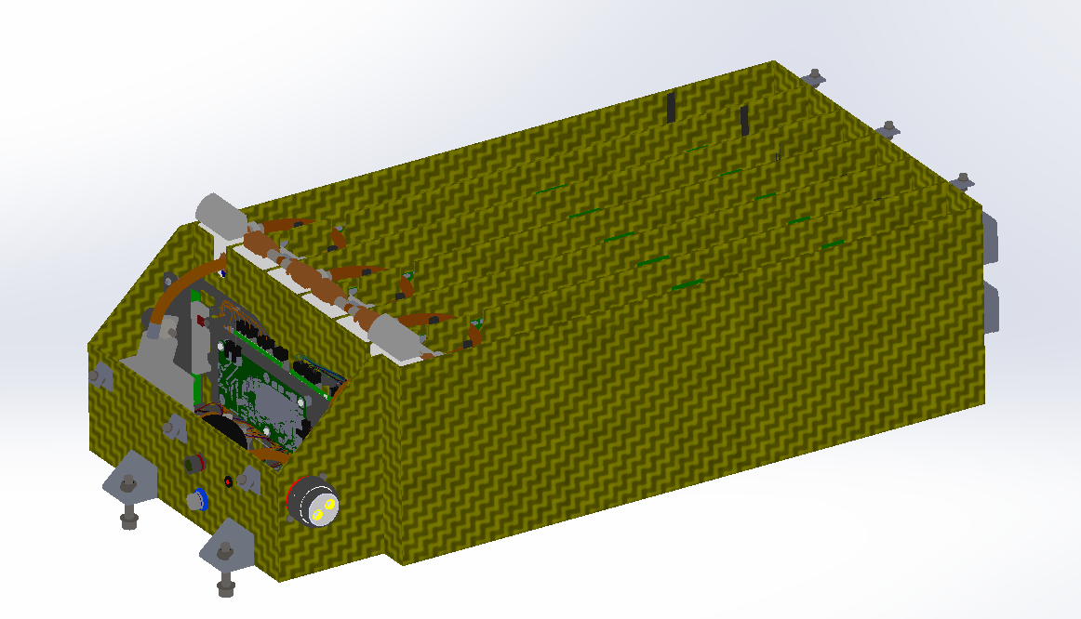




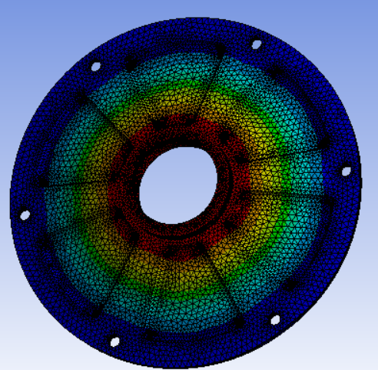
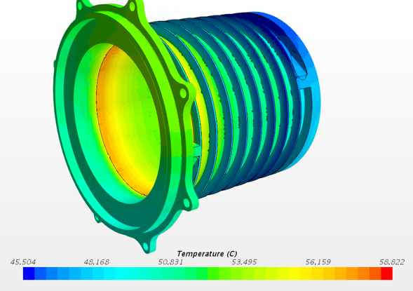


POWERTRAIN
SOFTWARE

Slide 10
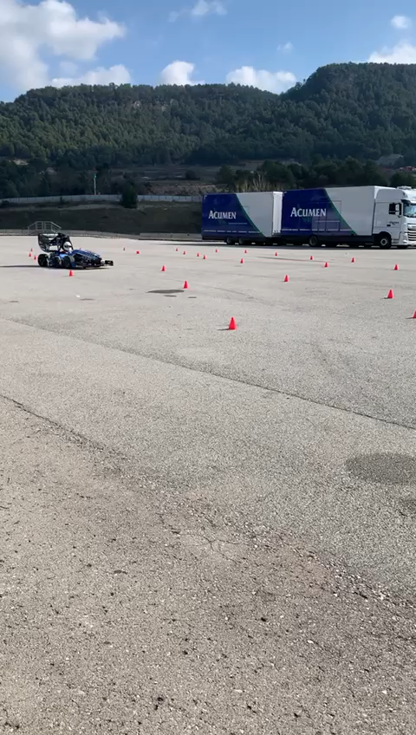
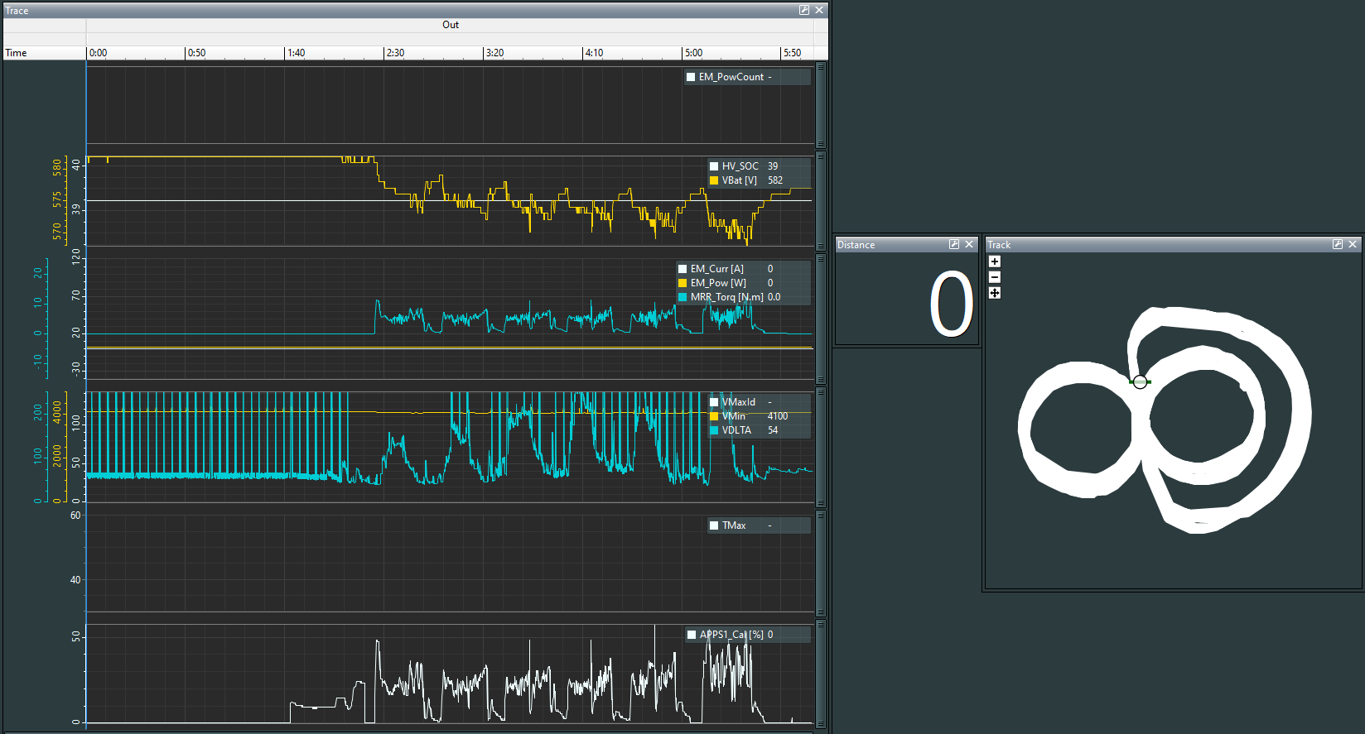
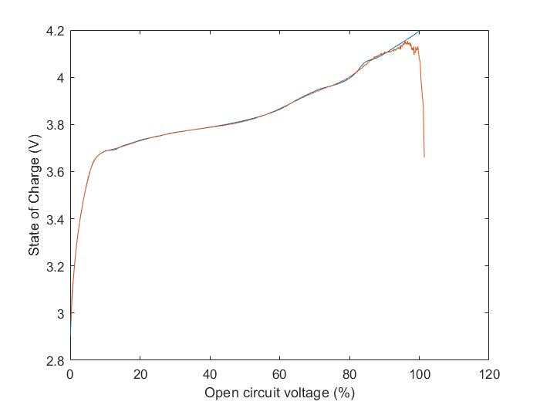
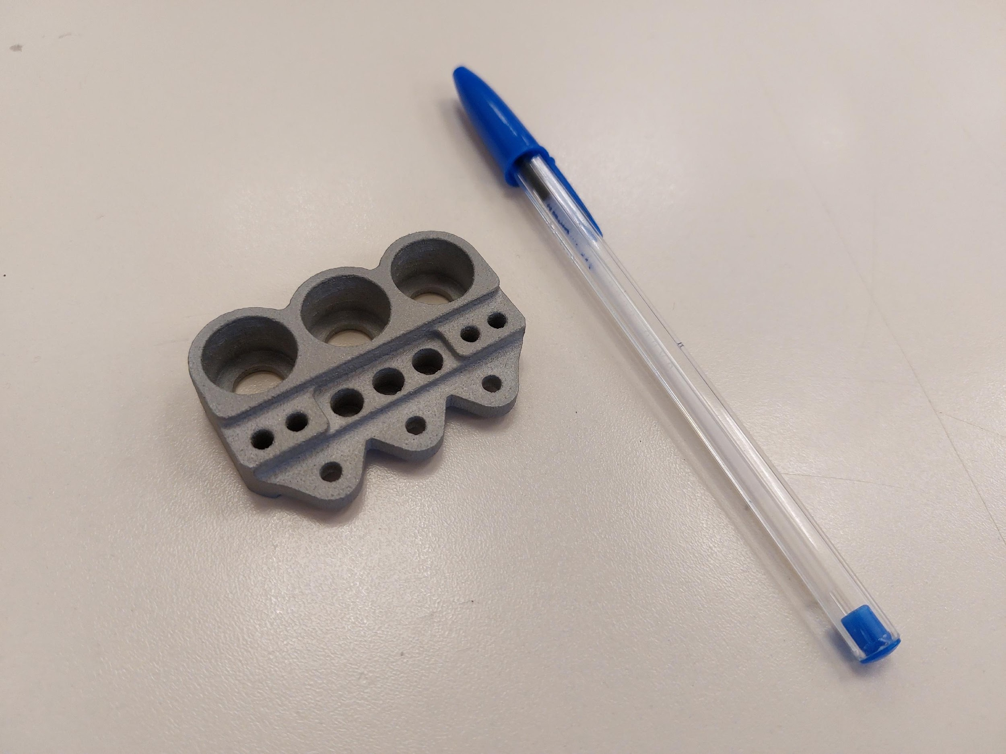
POWERTRAIN
VALIDATING

Slide 11
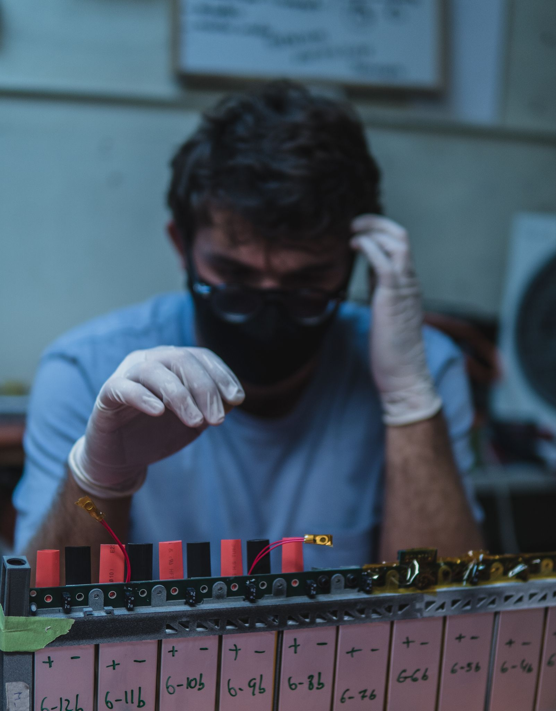
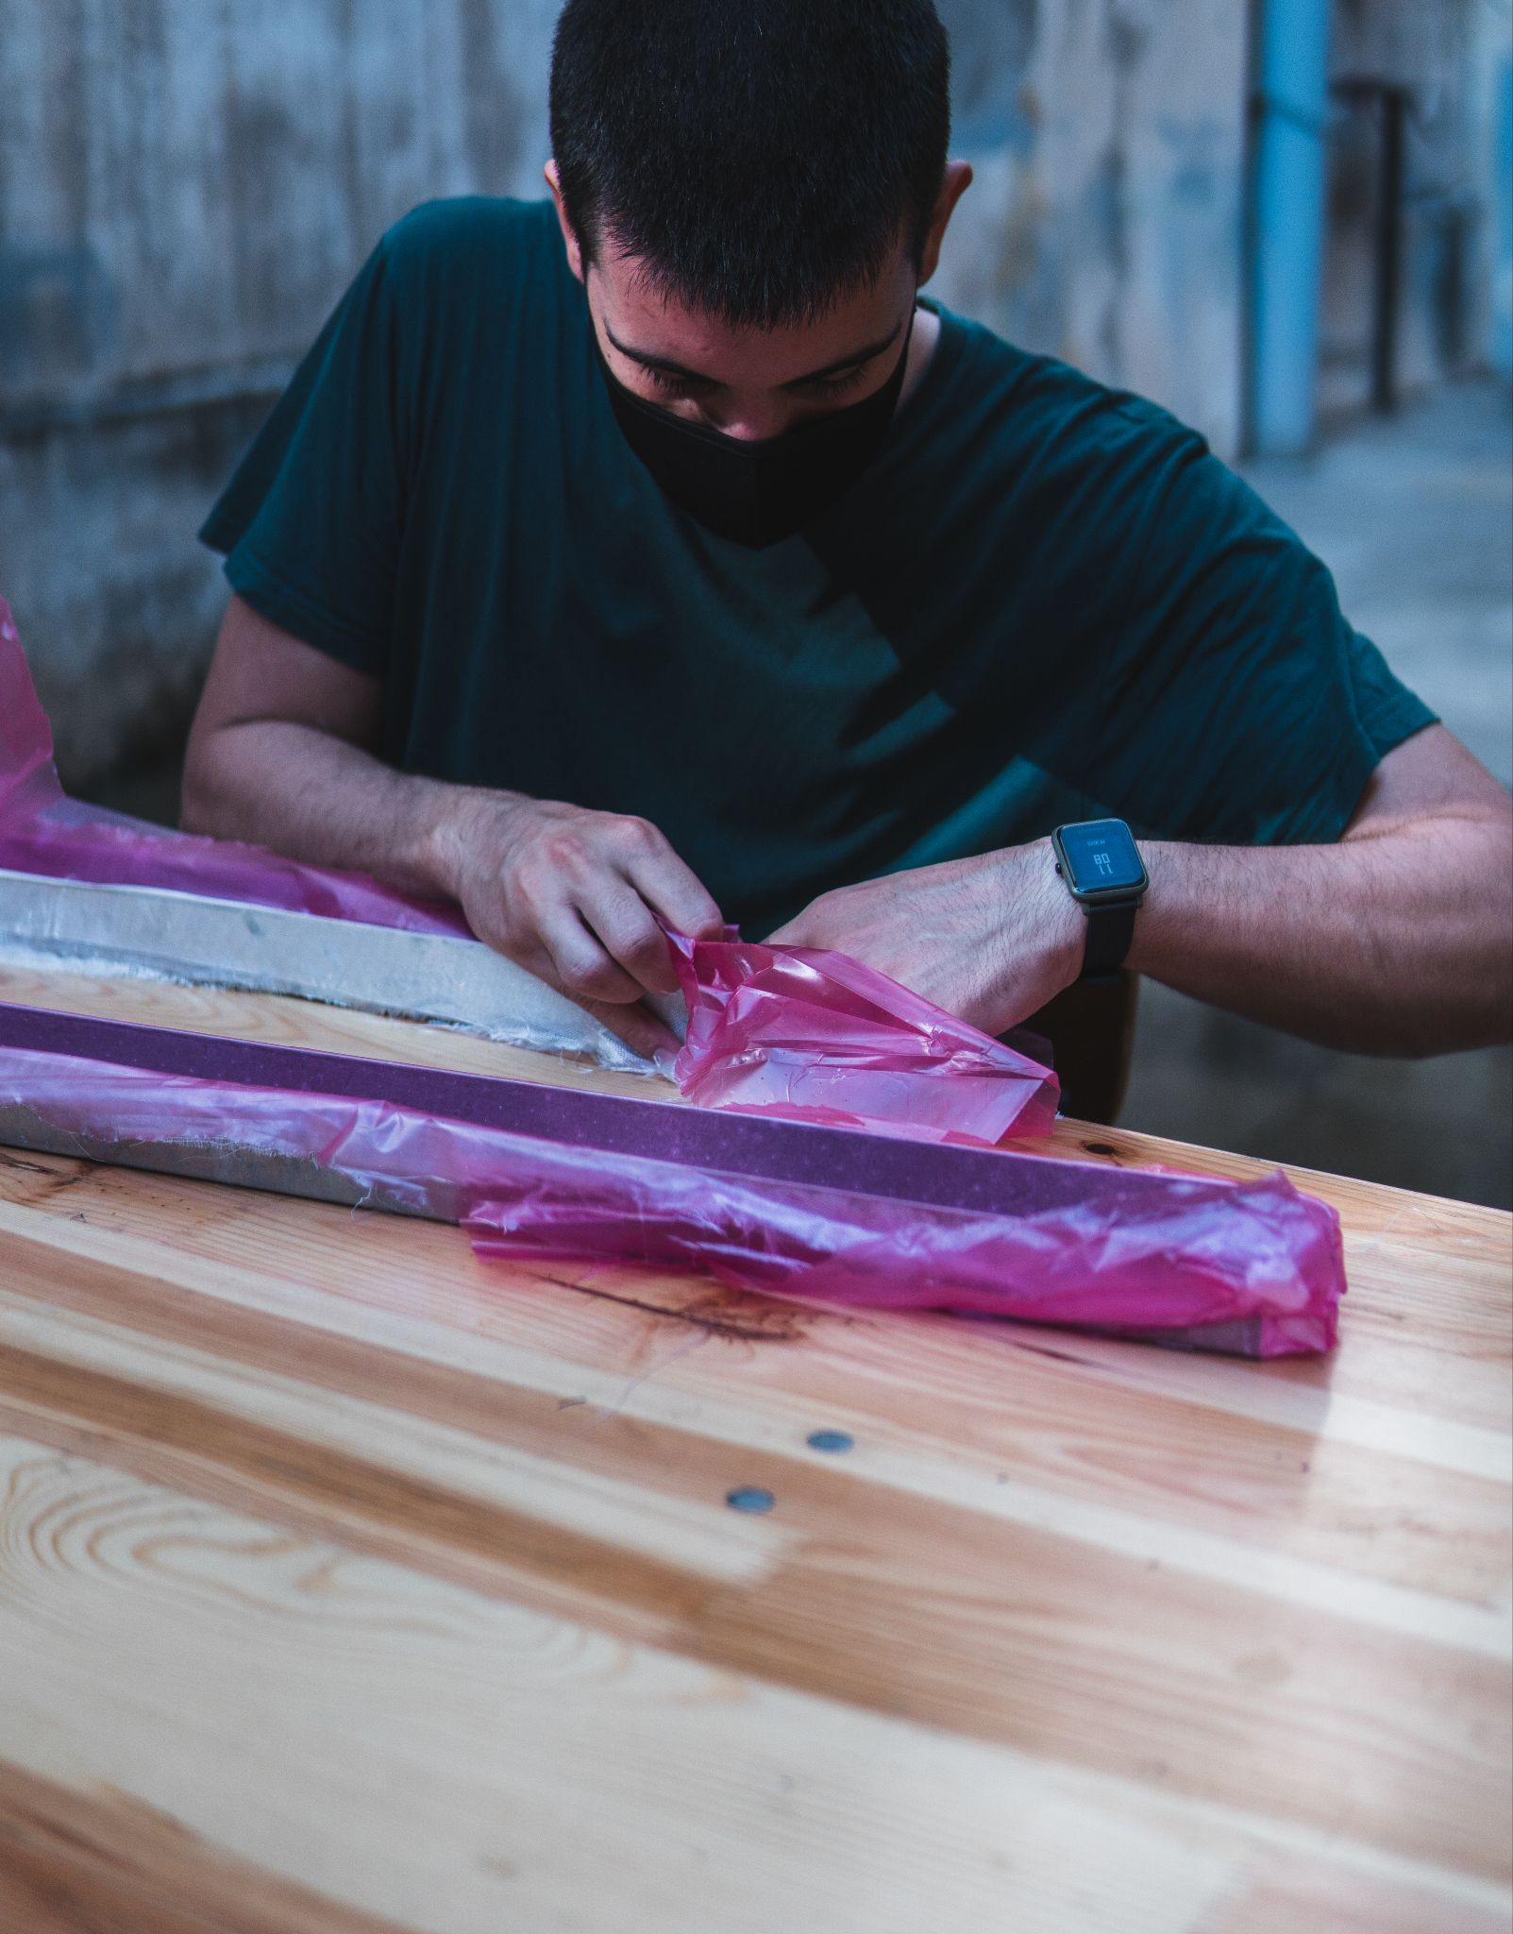
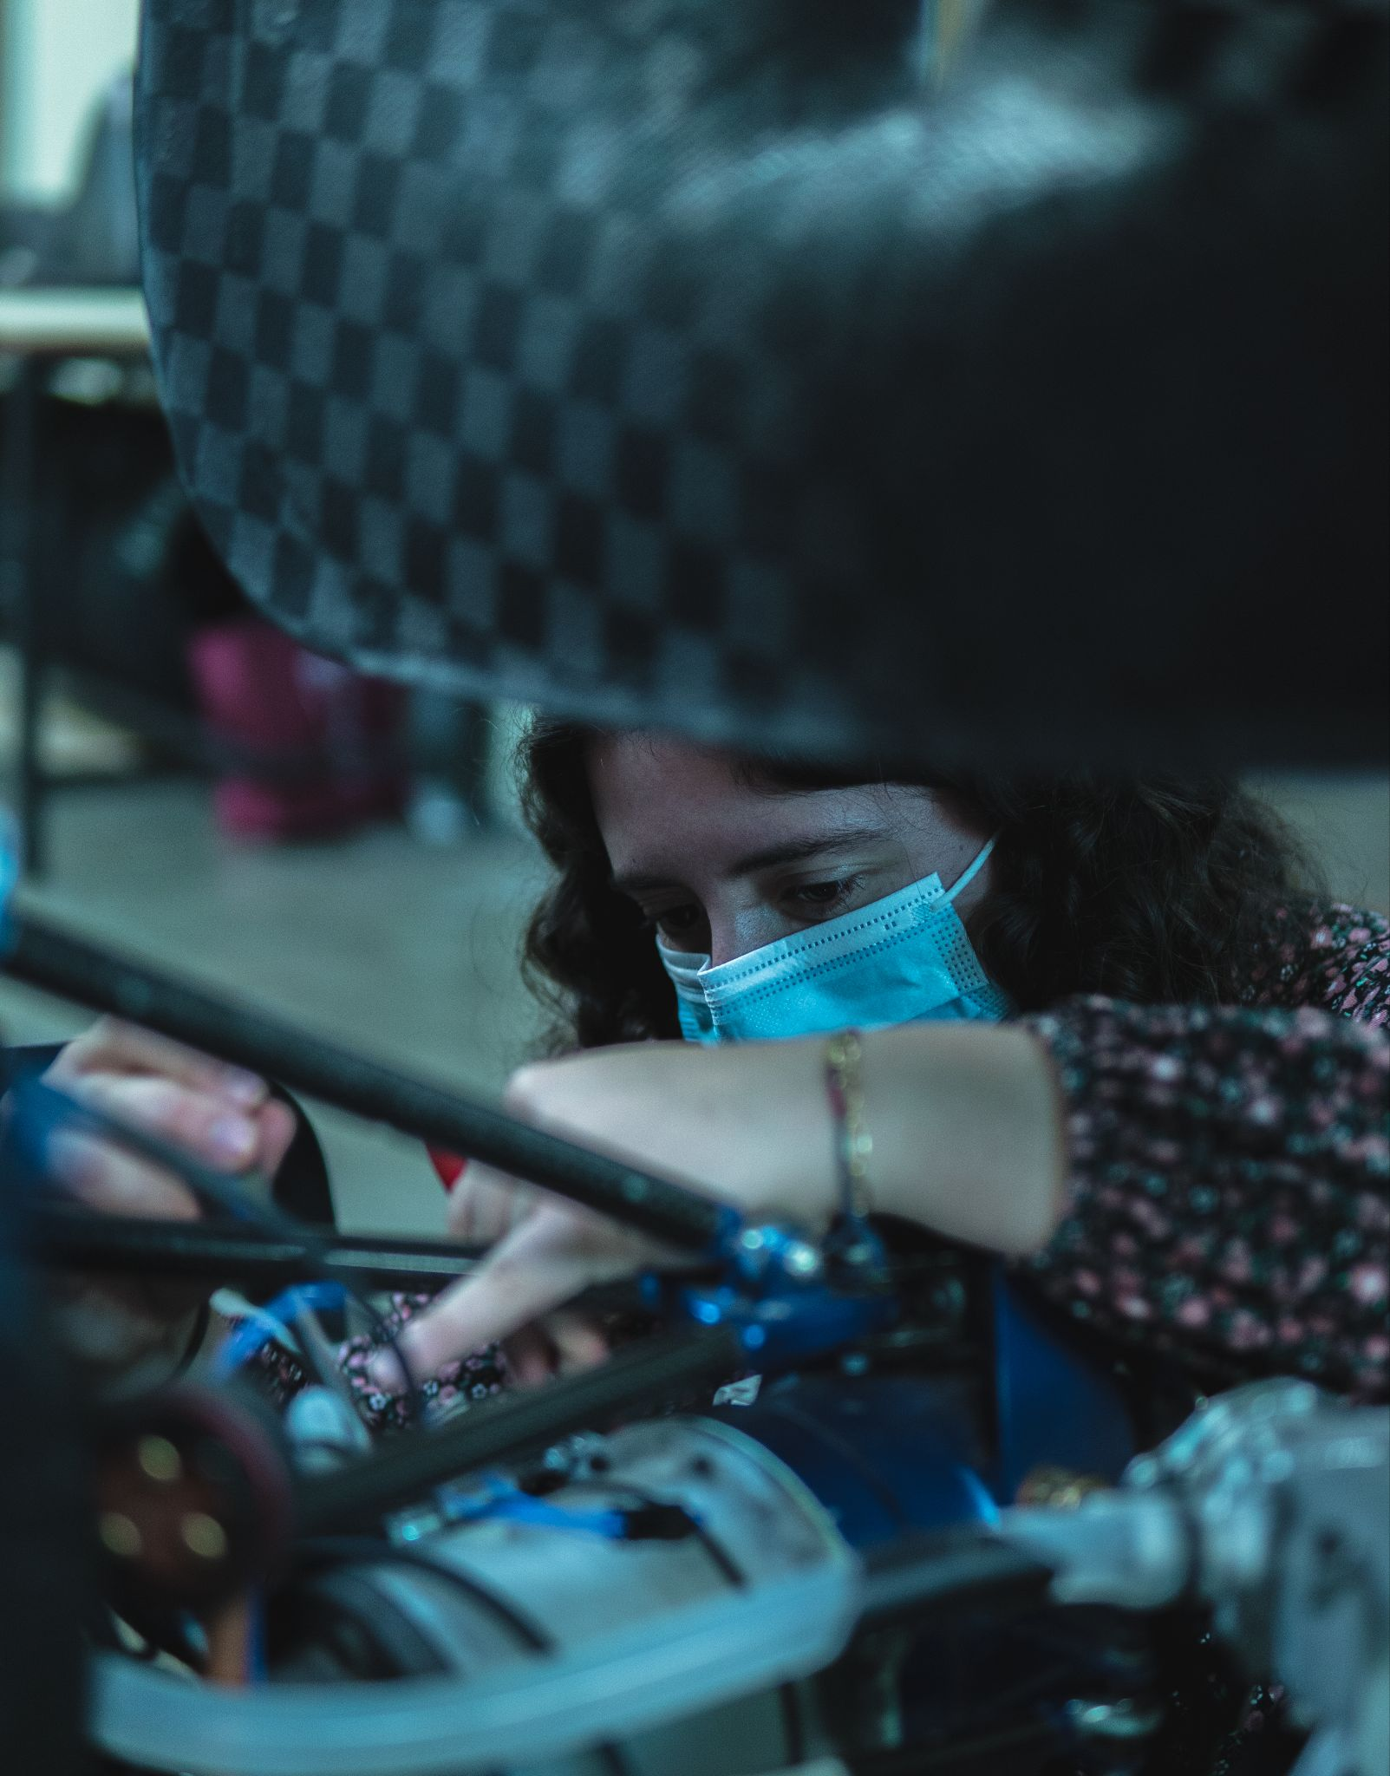
POWERTRAIN
MANUFACTURING

